Slide 1
Data Structures and Algorithms
Lecture 06

Slide 2
Outlines
Queue
Defining Queue Class
Enqueue and Dequeue operations
Problem with Simple Queue

Slide 3
Queue
A queue is a data structure that is based upon first-come first-serve order, or first-in first-out (FIFO) order.
A Queue or FIFO (First in, first out) is an abstract data type that serves as a collection of elements, with two principal operations: enqueue, which adds an element to the collection, and dequeue, which removes the first element that was added.
The elements that are inserted first will be removed first, and similarly, the elements that are inserted last will be removed last.

Slide 4
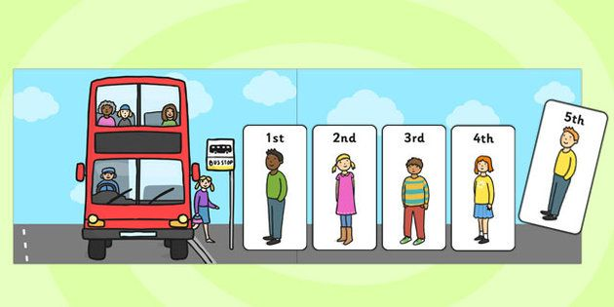
Example

Slide 5

Example

Slide 6
Queue Operations
Insert(item): (also called enqueue)
It adds a new item to the end of the queue
Remove( ): (also called delete or dequeue)
It deletes the head item of the queue, and returns to the caller. If the queue is already empty, this operation returns NULL
getHead( ):
Returns the value in the head element of the queue
getTail( ):
Returns the value in the tail/end element of the queue
isEmpty( )
Returns true if the queue has no items
size( )
Returns the number of items in the queue

Slide 7
More About Queue
A Queue consist of
Front
Represents start of the queue. Element are always dequeued from front.
Rare
Represents end of the queue. Elements are always enqueued from rare.

Slide 8
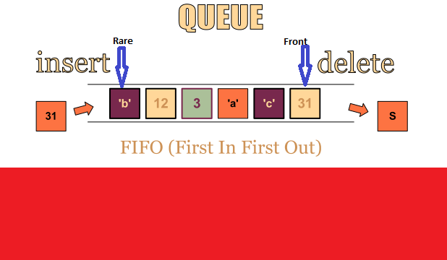
Example of Queue

Slide 9
A queue Class based on Array
class Queue{
private:
int front, rare, length,capacity;
double* arr;
public:
Queue(int cap)
{
front=0; //represents the head of queue
rare=0; //represents the tail/end of queue
length=0; //represents total elements in queue
capacity=cap; //represents total capacity of queue
arr=new double[capacity];
}

Slide 10
How head and tail Change
head increases by 1 after each dequeue( )
tail increases by 1 after each enqueue( )
Now:
49
48
47
4
3
2
1
0
After enqueue:
49
48
47
4
3
2
1
0
After dequeue:
49
48
47
4
3
2
1
0

Slide 11
How head and tail Change
head increases by 1 after each dequeue( )
tail increases by 1 after each enqueue( )
After dequeue:
49
48
47
4
3
2
1
0
After enqueue:
49
48
47
4
3
2
1
0

Slide 12
Example: enqueue
void enqueue (double val)
{
if (length<capacity)
{
arr[rare]=val; //arr[0]=10
length++;
rare=rare+1;
cout<<"value added "<<val<<endl;
}
else
{
cout<<"queue is full"<<endl;
}
}

Slide 13
Example: enqueue
void enqueue (double val)
{
if (length<capacity)
{
arr[rare]=val;
length++;
rare=rare+1;
cout<<"value added "<<val<<endl;
}
}
Front and Rare
49
48
47
4
3
2
1
0
capacity=50
length=0

Slide 14
Example: enqueue
void enqueue(double val)
{
if (length<capacity)
{
arr[rare]=val;
length++;
rare=rare+1;
cout<<"value added "<<val<<endl;
}
}
Front and Rare
49
48
47
4
3
2
1
0
capacity=50
length=0

Slide 15
Example: enqueue
void enqueue(double val)
{
if (length<capacity)
{
arr[rare]=val;
length++;
rare=rare+1;
cout<<"value added "<<val<<endl;
}
}
Front and Rare
49
48
47
4
3
2
1
0
capacity=50
length=1

Slide 16
Example: enqueue
void enqueue(double val)
{
if (length<capacity)
{
arr[rare]=val;
length++;
rare=rare+1;
cout<<"value added "<<val<<endl;
}
}
rare
Front
49
48
47
4
3
2
1
0
capacity=50
length=1

Slide 17
Example: enqueue
void enqueue(double val)
{
if (length<capacity)
{
arr[rare]=val;
length++;
rare=rare+1;
cout<<"value added "<<val<<endl;
}
}
rare
Front
49
48
47
4
3
2
1
0
capacity=50
length=1

Slide 18
Example: enqueue
void enqueue(double val)
{
if (length<capacity)
{
arr[rare]=val;
length++;
rare=rare+1;
cout<<"value added "<<val<<endl;
}
}
rare
Front
49
48
47
4
3
2
1
0
capacity=50
length=2

Slide 19
Example: enqueue
void enqueue(double val)
{
if (length<capacity)
{
arr[rare]=val;
length++;
rare=rare+1;
cout<<"value added "<<val<<endl;
}
}
rare
Front
49
48
47
4
3
2
1
0
capacity=50
length=2

Slide 20
Example: enqueue
void enqueue(double val)
{
if (length<capacity)
{
arr[rare]=val;
length++;
rare=rare+1;
cout<<"value added "<<val<<endl;
}
}
rare
Front
49
48
47
4
3
2
1
0
capacity=50
length=3

Slide 21
Example: dequeue
Suppose 5 enqueue have been made. Now, we like to dequeue 2 elements
rare
Front
49
48
47
47
4
3
2
1
0
capacity=50
length=5

Slide 22
Example: dequeue
double dequeue()
{
double value;
if (length>0)
{
value=arr[front];
front=front+1;
length--;
}
return value;
}
rare
Front
49
48
47
4
3
2
1
0
capacity=50
value= value at index 0
length=5

Slide 23
Example: dequeue
double dequeue()
{
double value;
if (length>0)
{
value=arr[front];
front=front+1;
length--;
}
return value;
}
rare
Front
49
48
47
4
3
2
1
0
capacity=50
value= value at index 0
length=5

Slide 24
Example: dequeue
double dequeue()
{
double value;
if (length>0)
{
value=arr[front];
front=front+1;
length--;
}
return value;
}
rare
Front
49
48
47
4
3
2
1
0
capacity=50
value= value at index 0
length=4

Slide 25
Example: dequeue
double dequeue()
{
double value;
if (length>0)
{
value=arr[front];
front=front+1;
length--;
}
return value;
}
rare
Front
49
48
47
4
3
2
1
0
capacity=50
value= value at index 1
length=4

Slide 26
Example: dequeue
double dequeue()
{
double value;
if (length>0)
{
value=arr[front];
front=front+1;
length--;
}
return value;
}
rare
Front
49
48
47
4
3
2
1
0
capacity=50
value= value at index 1
length=4

Slide 27
Example: dequeue
double dequeue()
{
double value;
if (length>0)
{
value=arr[front];
front=front+1;
length--;
}
return value;
}
rare
Front
49
48
47
4
3
2
1
0
capacity=50
value= value at index 1
length=3

Slide 28
Overflow Issue
Suppose 50 enqueue have been made when program starts, so now the queue array is full
Assume 4 calls to dequeue( ) are made
Assume a call to enqueue( ) is made now. The tail part seems to have no space, but the front has 4 unused spaces; if never used, they are wasted.
49
48
47
4
3
2
1
0
49
48
47
4
3
2
1
0

Slide 29
Solution
Use modulus to increment front and rare.
void enqueue(double val)
{
if (length<capacity)
{
arr[rare]=val;
length++;
rare=rare+1%capacity;
cout<<"value added "<<val<<endl;
}
}
rare
Front
49
48
47
4
3
2
1
0
capacity=50
length=3
Notes:
amodb=a−b×⌊a/b⌋, a mod b = Dividend (a) - [Divisor (b) × Quotient]
If a is smaller than b, then a % b = a

Slide 30
Example: dequeue
double dequeue()
{
double value;
if (length>0)
{
value=arr[front];
front=front+1%capacity;
length--;
}
return value;
}
rare
Front
49
48
47
4
3
2
1
0
capacity=50
value= value at index 1
length=3

